Slide 1
Instance Segmentation within Unity VirtualHome Environment
Research for Master’s Project CMPE 295
Primary Author: Adam Goldstein
Co-Authors: Aishwarya Paruchuri, Krupaben Kothadia, Ryan Cummings
Advisor: Dr. Harry Li
Affiliation: San Jose State University, Department of Computer Engineering
Date: May 2023

Slide 2
Problem Statement
Virtual Environment Applications: Enhance computer vision capabilities in virtual environments for various applications, such as robotics, training, and simulation.
Real-World Testing Limitations: Overcome the challenges and constraints of physical real-world testing by leveraging a virtual environment.
Efficient Performance: Address the need for real-time object detection and segmentation in virtual environments without compromising accuracy.
Scalability and Adaptability: Facilitate the development of scalable and adaptable computer vision solutions that can be applied across various virtual and real-world scenarios.

Slide 3
Project Overview
Objectives: Develop a real-time object detection and segmentation system for Unity VirtualHome to enhance computer vision applications in virtual environments.
Method: Utilize YolactEdge, a state-of-the-art instance segmentation algorithm implemented with PyTorch.
Synthetic Data: Generate and curate synthetic data for training the YolactEdge model using Unity Synthetic Homes and the FiftyOne dataset processing tool.
Integration: Optimize YolactEdge for real-time performance within Unity using TCP/IP socket communication via NetMQ and ZeroMQ messaging libraries.

Slide 4
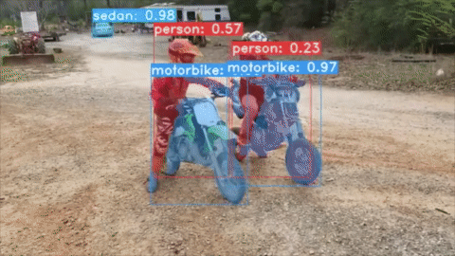
YolactEdge: A State-of-the-Art Instance Segmentation Algorithm
State-of-the-art performance: YolactEdge provides competitive instance segmentation results compared to other algorithms, making it a suitable choice for real-time applications
Real-time processing: YolactEdge is designed for efficient, real-time object detection and segmentation, which is critical for seamless integration into the Unity VirtualHome environment.
TensorRT Optimization: YolactEdge leverages GPU acceleration and is compatible with NVIDIA's TensorRT, a high-performance deep learning inference optimizer, enabling faster processing.
Lightweight architecture: The model's architecture is less complex and resource-intensive than alternative approaches, making it ideal for implementation in a real-time system. (Liu 2021)
Real-time instance segmentation inference generated by YolactEdge

Slide 5
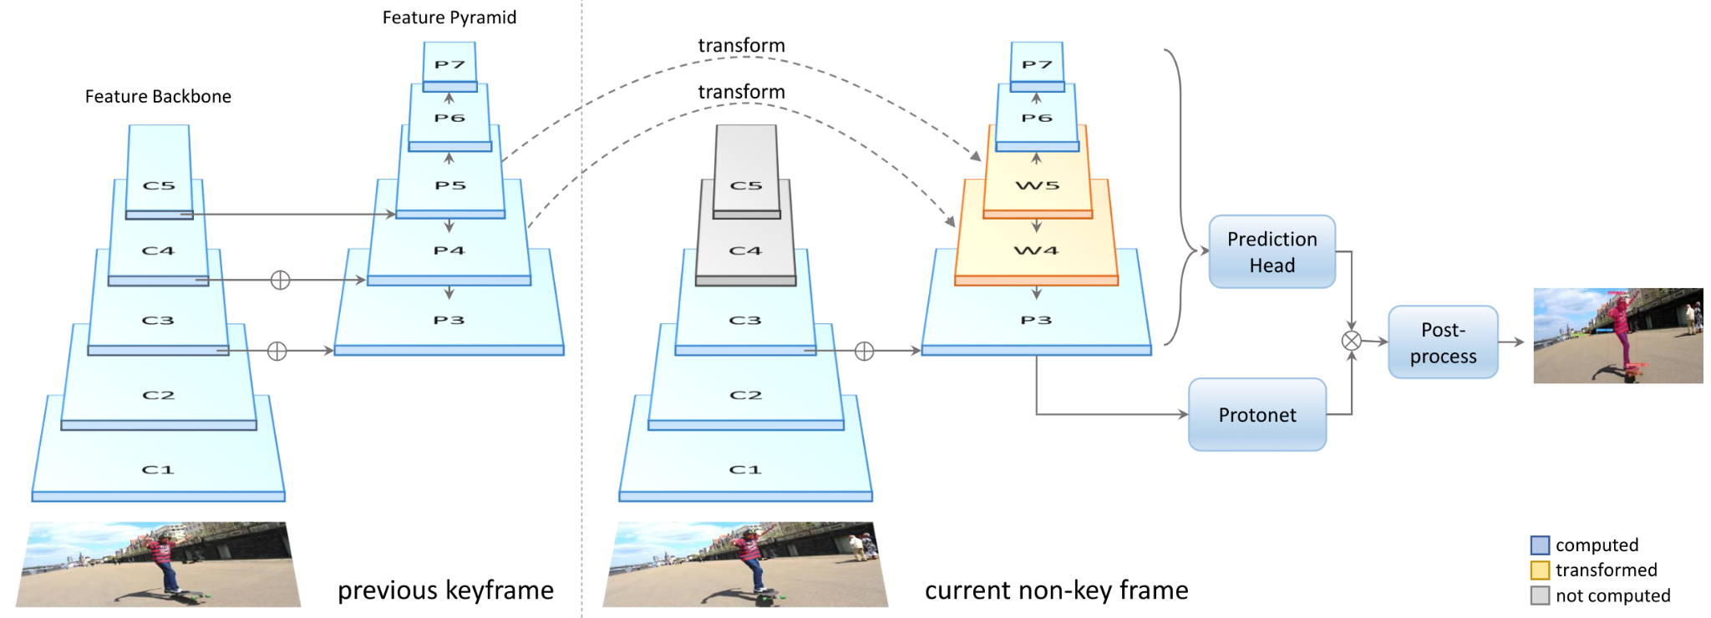
YolactEdge Architecture
YolactEdge for Video: Extension of YOLACT optimized for video processing by reducing expensive backbone computation.
Keyframes and Non-Keyframes: Keyframes (left) provide a reference for transforming a subset of features to non-keyframes (right).
Efficient Computation on Non-Keyframes: Compute C features, which are cost-effective yet crucial for high-resolution mask prediction, accelerating the process while maintaining accuracy. (Liu, 2021)

Slide 6
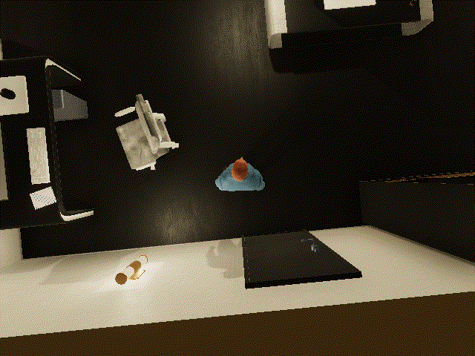
Unity VirtualHome: A Versatile Environment for Computer Vision Applications
Immersive simulation: Unity VirtualHome offers a realistic and customizable 3D environment that replicates various indoor scenarios, ideal for developing and testing computer vision applications.
Rapid prototyping: The platform enables quick development and iteration of virtual scenarios, reducing the time and resources needed for real-world testing.
(X. Puig 2018)
The Unity VirtualHome Environment

Slide 7
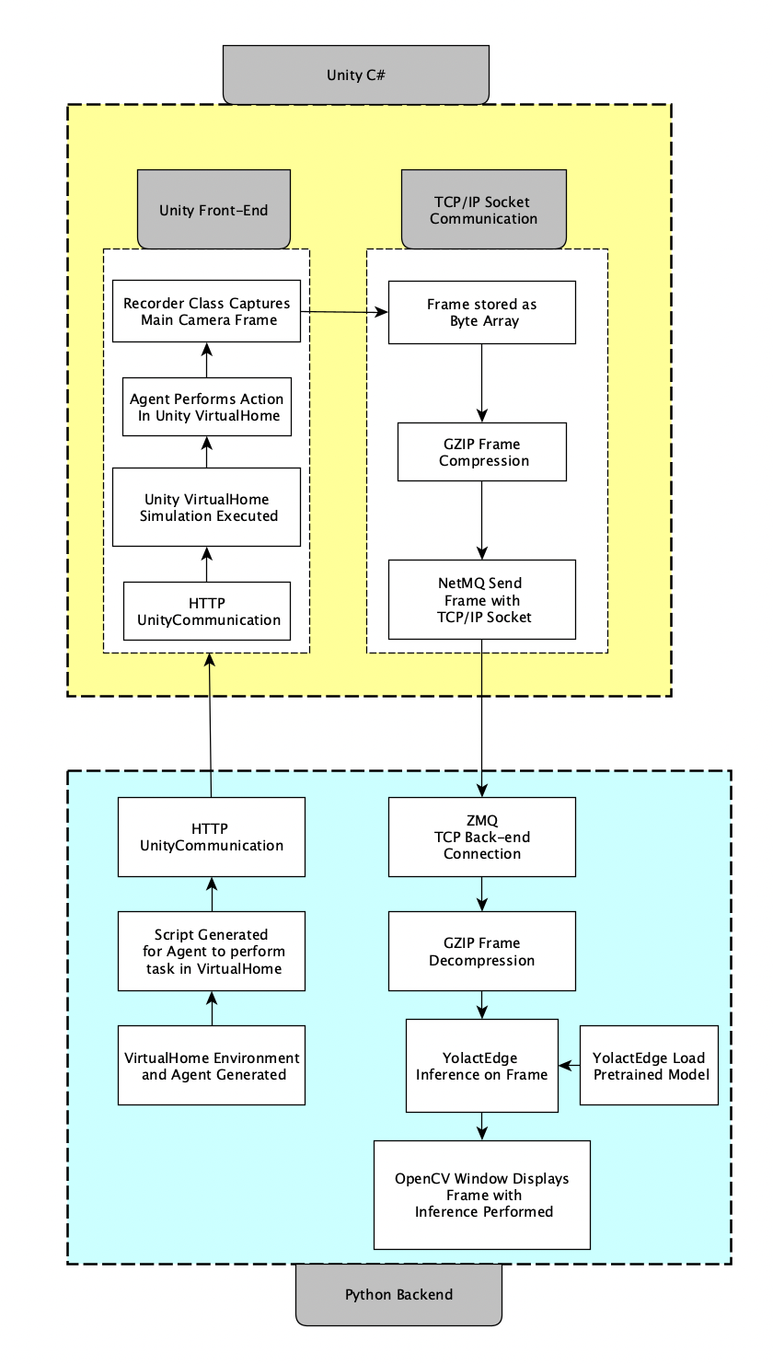
System Architecture
Architecture diagram: shows interface between Python script and Unity VirtualHome for object detection and segmentation with YolactEdge.
Communication: with NetMQ used for TCP/IP Socket Communication to send compressed frames from Unity to Python script.
YolactEdge: model loaded for inference and OpenCV used to display segmented frames, enabling real-time object detection and segmentation in virtual environment.

Slide 8
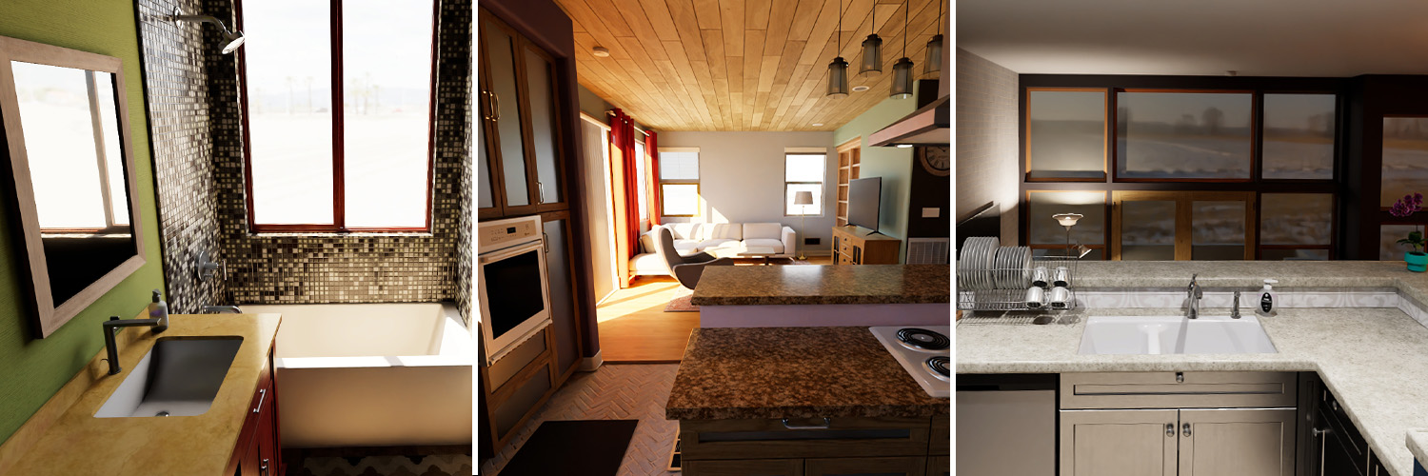
Unity SyntheticHomes
Cost-effective: Training on synthetic data reduces the need for expensive and time-consuming real-world data collection.
Customizable: Synthetic data generation allows for control over the scenarios, objects, and conditions, enabling targeted model training.
Scalability: Large volumes of diverse synthetic data can be generated quickly, providing a rich training set for the model. (Unity Technologies 2022)

Slide 9
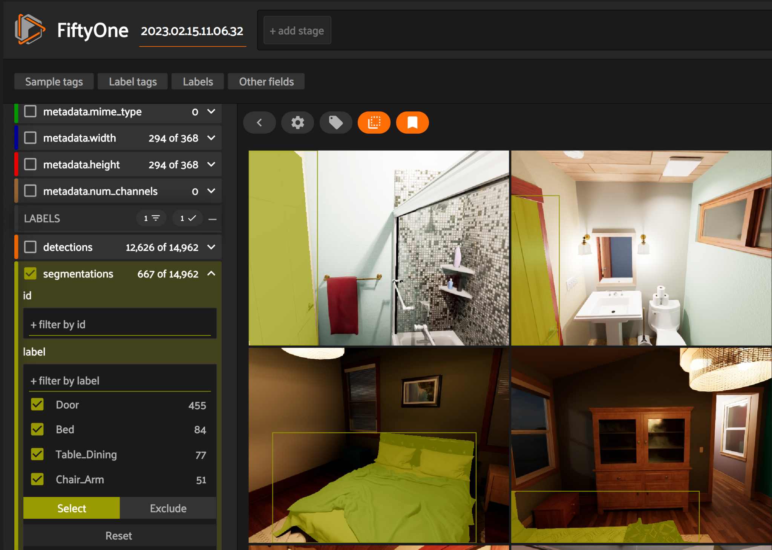
FiftyOne Data Annotation Tools
Efficient annotation: FiftyOne streamlines the process of labeling and annotating synthetic data, ensuring accurate and consistent training input.
Quality control: FiftyOne enables easy visualization and inspection of annotated data, allowing for quality checks and refinements. (Moore 2020)
The FiftyOne Annotation Interface

Slide 10
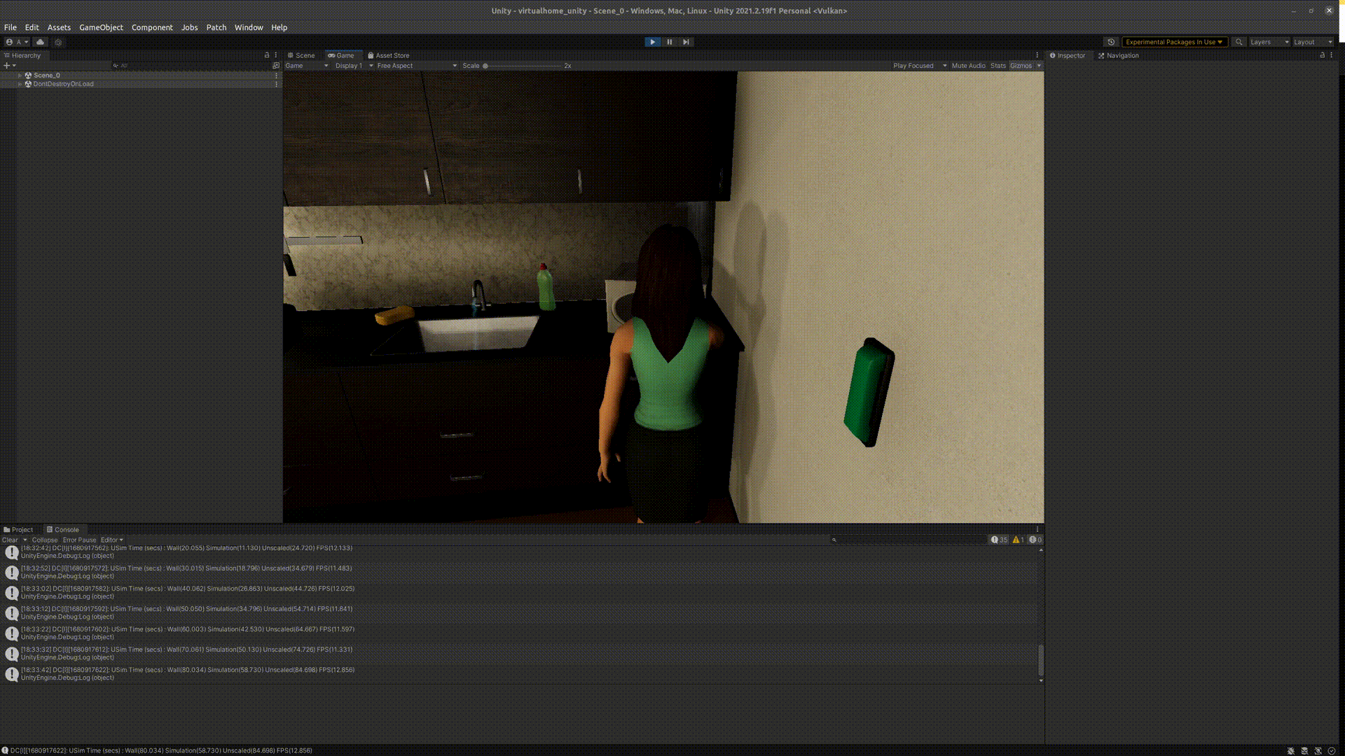
Integration with VirtualHome using TCP/IP Socket Communication
Seamless data transfer: Implementing TCP/IP socket communication with NetMQ and ZeroMQ messaging libraries enables efficient data exchange between the Unity application and the YolactEdge Python program.
Real-time performance: This integration approach supports real-time object detection and segmentation within the Unity VirtualHome environment.

Slide 11
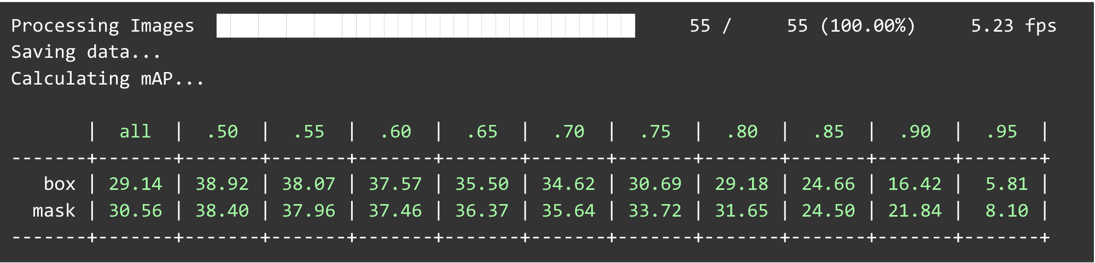
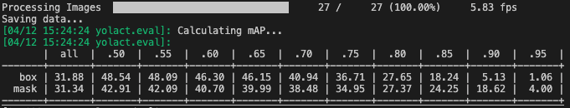
Results - Metrics
Custom Model trained on 1080Ti
Custom Model trained in HPC

Slide 12
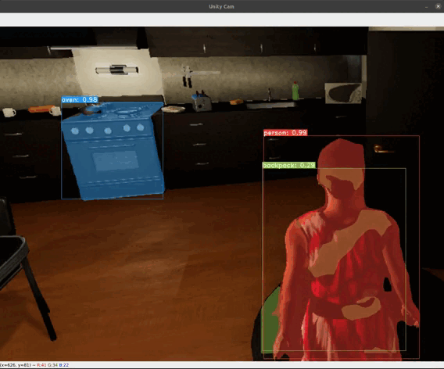
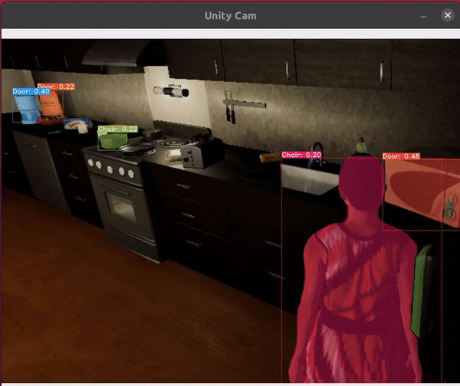
Results - Applied
Pre-trained model trained on the COCO Dataset far outperformed custom trained model
COCO Pre Trained Model
Custom Trained Model

Slide 13
Discussion
Leveraging the COCO pretrained model with concatenated classes was more effective than training the model from scratch, as it allowed us to leverage a model that was trained on a massive dataset with significant computational resources.
However, training the model from scratch with synthetic indoor environment data may be more optimal for our specific application.
This approach requires significant computing resources and data to train and validate the model, which can be a significant challenge.
Running the model on edge computing devices poses challenges due to resource constraints, which can limit the ability to perform real-time inference in some cases.

Slide 14
Conclusion
Project is a novel integration of the YolactEdge instance segmentation algorithm with the Unity VirtualHome environment, enabling real-time object detection and segmentation in a virtual environment.
This integration demonstrates potential techniques to address the challenge of performing accurate inference in real-time
Project has use cases in the fields of robotic vision and indoor augmented reality

Slide 15
Acknowledgements
Acknowledgements: We would like to express our sincere gratitude to Dr. Harry Li for his invaluable guidance, mentorship, and support throughout this project.
His expertise and insights have been instrumental in shaping our approach and achieving our goals. Thank you for your unwavering commitment and dedication.

Slide 16
References
1 | H. Liu, R. A. R. Soto, F. Xiao, and Y. J. Lee, “YolactEdge: Real-time instance segmentation on the edge,” arXiv [cs.CV], 2020.
2 | X. Puig et al., “VirtualHome: Simulating household activities via programs,” arXiv [cs.CV], 2018.
3 | Voxel51, "FiftyOne," [Online]. Available: https://voxel51.com/docs/fiftyone/. [Accessed: Apr. 11, 2023].
4 | Unity Technologies, "Unity SyntheticHomes," [Online]. Available: https://unity.com/products/synthetic-data/synthetic-homes. [Accessed: Apr. 11, 2023].

